Slide 1


HMRC Customs Declaration Service (CDS)
Software Developer
Runbook
February 2024
Version 4.3

Slide 2
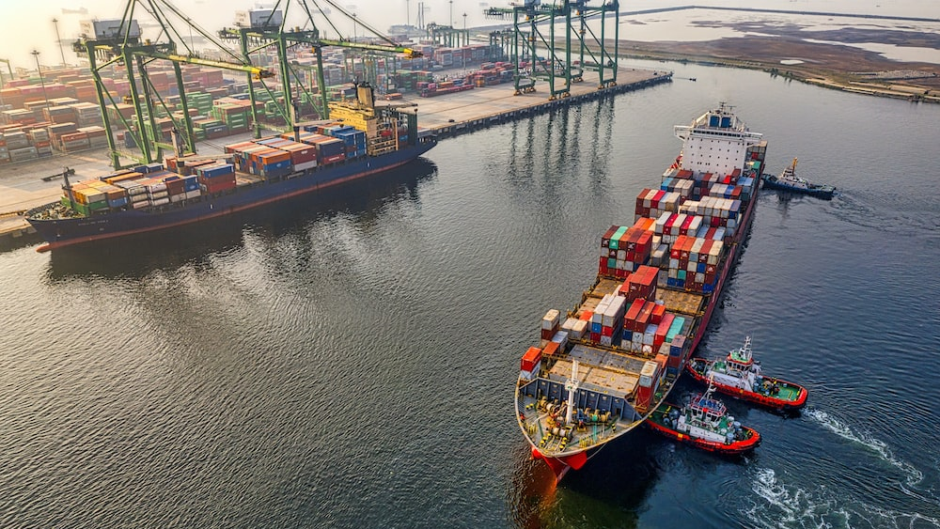







Contents
This Runbook has been designed to help Software Developers (both independent or in-house) and Declarants.
It will also support Traders and Intermediaries such as Brokers & Community System Providers (CSPs) who are involved in both the Import and Export of goods from the UK.
Introduction
Trade Test (TT)
Trader Dress Rehearsal (TDR)
CDS Live
Help & Support
Query Process
Glossary

Slide 3

Runbook

Slide 4






Introduction
Here you will find best practice guidance for Software Developers who are creating their own Customs application.
Each of the stages outlined on the left are made up of several smaller steps which must be completed to ensure smooth access to CDS Live.
While the process has been designed to be completed in sequential steps, some Software Developers will find it helpful to maintain ongoing, simultaneous access to all 3 environments as this will offer flexibility to quickly incorporate future developments.
Equally, some may wish to work in each environment independently and at different points of their development and testing cycles.
It is important to recognise all stages will require close collaboration between Software Developers, Declarants and HMRC.
Before a Declarant can authorise a Software Developer’s application to begin making declarations on their behalf, they must sign-in to the authorisation page using their Government Gateway account and grant the application authority to access certain scopes.
Declarants who do not correctly set up or maintain their Government Gateway ID details may experience delays or be unable to access the service.
There are 3 stages to the journey:
1
Trade Test
Software Developers Only
2
Trader Dress Rehearsal
Software Developers & Declarants
3
CDS Live
Software Developers & Declarants

Slide 5
Welcome to Trade Test

Slide 6

Introduction to Trade Test
Trade Test offers Software Developers an environment where they can test their application.
Trade Test (TT) enables initial environment building.
Unlike Trader Dress Rehearsal (TDR) & CDS Live, it is only accessible to Software Developers.
Trade Test provides a functional test platform where Developers are able to assure their software against CDS APIs and a CDS back-end for all core declaration processes and notification types.
While Trade Test represents the first milestone on the journey to CDS Live, it is important to note that it may also be used as an ongoing build environment, used to test functionality of future releases.
Only test data should be used in Trade Test, as it is not the CDS Live environment. Importantly, Software Developers will also need to create a test user account.
For more information visit Developer Hub: Technical Documentation.
Trade Test Functionality
Test Trader and account data.
Process all declaration types and procedures.
Integration testing for all APIs.
Scripts to facilitate testing of software developer’s environment build.
Exports inventory linking, including dual running arrivals via CHIEF (HMUT).
Simulated controls, management of tariff quotas, quantities and periods & immediate payments services.
6

Slide 7
Connecting to Trade Test
1
Create an application and register the ID via Developer Hub.
Once a Software Developer has created an application, they can request access to the Trade Test environment where they can assure their software integration against CDS APIs and a CDS back-end.
As it is not the CDS Live environment, only test data should be used. Developers are also required to create a test user account.
2
Request access to Trade Test APIs from SDST who will authenticate the application.
3
Access Developer Hub & subscribe to the APIs, ensuring subscription configuration fields are completed if applicable (e.g. Callback URL for push notifications).
4
Create a test user account by calling the Create Test User API.
5
Generate a Bearer token for Trade Test.
6
Check the correct API version in the Accept Header.
7
Submit declaration payloads with test data & successfully complete declaration scenarios.
Trade Test can be used as an ongoing build environment to test functionality for future releases.
Software Developers must have proven their software in Trade Test before it can be used in Trader Dress Rehearsal.

Slide 8
Entering Trader Dress Rehearsal

Slide 9





Trader Dress Rehearsal for Imports and Exports
Trader Dress Rehearsal is an optional service that offers Declarants the opportunity to practice making declarations before entering CDS Live.
The benefits of Trader Dress Rehearsal for Exports include:
Declarants and Traders can test their supply chain and prove all associated declaration data such as authorisation references, licenses, EORI, deferment account information before moving to CDS Live.
Loaders can utilise Trader Dress Rehearsal to test their CDS declaration scenarios before moving onto CDS. Loaders can also prove their loader authorisations including arrival and departure location authorisations.
Trader Dress Rehearsal (TDR) is a safe practice environment where Declarants can practice submitting different types of Import and Export declarations. It is free to use and designed to help Declarants and Loaders prepare to go live.
Trader Dress Rehearsal allows Declarants to use their real account data such as EORIs, duty deferment account numbers, authorisations and licences without creating any legal obligations.
Trader Dress Rehearsal is recommended because it improves success rates when submitting declarations in CDS Live.
Trader Dress Rehearsal provides a unique opportunity to explore and understand the key differences between CHIEF and CDS.
Before accessing Trader Dress Rehearsal, Declarants should have a plan to access CDS Live. Readiness includes:
Correct setup of their Government Gateway User ID
Registering for an EORI, if they have not done so already.
Access to their authorisations & licences.
Checklists for Exports.
It is important to remember that Trader Dress Rehearsal is practice environment and not to be used for performance or technical testing.

Slide 10
Connecting to TDR for the First Time
Connecting to TDR has been designed to be both simple & straightforward.
The connection process is similar to TT but Declarants will use their real account data.
A Software Developer, on behalf of their Declarant, must request access to the TDR environment from SDST, who will review and verify the application before providing the required API versions.
Software Developers may also find it helpful to notify TDR Comms at the same time, who can add their details to the distribution list for all future communication messages such as planned outages and unexpected Loss of service.
As with TT, it is a good idea to maintain ongoing access to the TDR environment.
Existing TDR users, please see slide 11.
TDR Setup & Proving:
1
Create an application and register the ID via Developer Hub. Alternatively, subscribe to TDR with the same application created for TT.
2
Request access to TDR APIs from SDST who will authenticate the Application.
3
Access Developer Hub & subscribe to the TDR APIs, ensuring subscription configuration fields are completed if applicable.
4
Create a test user account by calling the Create Test User API.
5
Generate a Bearer token for TDR.
6
Check the correct API version in the Accept Header.
7
Declarants submit declaration payloads with real data & successfully complete declaration scenarios.
APIs currently available in TDR:
Customs Declarations 1.0 | Customs Inventory Linked Exports 2.0 | Customs Declaration Information 2.0 | Pull Notifications 1.0
More information about APIs can be found on the Developer Hub.
10

Slide 11
Access to Exports as an Existing TDR User
Declarants who have used TDR for Imports do not need to repeat the setup process in order to submit Export declarations.
CSPs and Software Developers
Declarants and Loaders with existing TDR access can continue to practice submitting Export declarations in TDR; no further access is required. Certain limitations apply (see slide 13 for more information).
Testing your movements and consolidations in TDR
CSPs/Software Developers must engage with declarants to help them to understand readiness for practicing their end-to-end CDS declaration journeys in TDR.
Export journeys involve Declarant and Loader specific roles, so the acceptance and subsequent departure may need to be carried out outside of the Declarant Role.
Subscribe your application to the Customs ILE API
You must subscribe each application you register to the CDS APIs that you intend to use.
To use the Customs Inventory Linking Exports API in TDR you must request access from SDST.
1
Modify your application’s ‘accept’ request header value
You must modify your application’s ‘accept’ request header value, when making a call to the API to reflect the version you wish to use.
2
Contact the SDST Team
If a version of an API is not visible or you cannot access specific API documentation, then please contact SDST (SDSTeam@HMRC.gov.uk).
3

Slide 12




Generating Bearer Tokens
HMRC’s API endpoints in TDR are user restricted so you’ll need a Bearer Token to be granted access.
API endpoints in TDR are user restricted and require a Bearer Token.
Each Software Developer should look to register a single application with HMRC. This application is used to identify the Software Developer during the OAuth 2.0 grant flow, and then in subsequent per user API calls. HMRC limit the number of requests each application can make. You can find more information here: Authorisations & End Points.
A Declarant uses the test user account to submit declarations in TDR and grants authority to the Software Developer’s application for specific scopes. HMRC then issue an OAuth 2.0 ‘access_token’ that is specific to that Declarant.
A Software Developer’s application passes the ‘access token’ in subsequent API requests to user-restricted API endpoints. A declarant’s ‘access_token’ expires after 4 hours and will need to be refreshed.
Full details and examples can here: HMRC Developer Hub.

Slide 13
Exports Functionality in TDR
TDR offers the following functionality for Exports:
Submitting type A, B, C, D, E, F, J, K, Y and Z declarations in accordance with the UK Trade Tariff
Receipt of trader notifications for the declaration submitted
Practicing ‘the arrival’ of goods
Requests for amendment and invalidation
Location-based loader-specific authorisations
Submitting declarations at inventory linked and non-inventory linked locations
Practicing the arrival and departure of a declaration using a declaration unique consignment reference at locations that do not use the Goods Vehicle Movement Service
For TDR, post-clearance cancellations are in scope for exports. TDR can accept a cancellation request for a cleared exports declaration that has not been departed.
TDR users can test the submission and validation of RoRo export declarations at GVMS locations (limited to submission and validation in CDS only, and not the full end to end journey)
TDR supports the ability to submit a declaration with an Administrative Reference Code (ARC) number declared for excise duty suspended goods
Assuring paper and electronic licence scenarios by entering the relevant document status codes
TDR can simulate Case management controls
Querying your declaration using the declaration information service
The following activities are not supported in TDR for Exports:
Arrival and departure of an export declaration via GVMS system
Arrival, departure and consolidation management of CHIEF export declarations, as exports dual running via CHIEF is not available in the TDR environment.
Common Agricultural Products (CAP) scenarios for Exports.
Limited MUCR responses (EMR will not be sent as stated in CR132).
Empty Movement Scenarios (impacted by CR132).
Paper license validation.
A selection of declarant facing user Interfaces, including those for financial statements and the file upload UI.
There is no functionality for the departure of an export declaration to trigger the closing of an entry in EMCS, as TDR processes dummy declarations and is not required to send data to the EU.
NB – As TDR uses real party data, available locations will be based on loaders’ authorised locations. Loaders’ access authorisations to arrive and depart at a particular port will be based on Production authorisations in CDS/CHIEF.

Slide 14

Inventory-Linked Functionality in TDR
The table below outlines the functional capabilities in TDR to process the E2E journeys of DUCRs and MUCRs at Inventory-Linked (IVL) locations.
 | DUCR | MUCR
Submission & Validation | Submission of a DUCR at IVL Locations Validation of a DUCR at IVL Locations | Submission of a MUCR at IVL Locations Validation of a MUCR at IVL Locations
Consolidations | Association of a DUCR to MUCR (EAC) Disassociation of DUCR from a MUCR (EAC) | Association of a MUCR/DUCR to MUCR (EAC) Disassociation of MUCR/DUCR from a MUCR (EAC) Shutting a Consolidation at MUCR level (EAC/CST)
Movements | Export Anticipated Arrival (EAA) Export Arrival at Location (EAL) Export Departure at Location (EDL) Empty Movements EAA/EAL response/CRC (CR132) | Export Anticipated Arrival (EAA) Export Arrival at Location (EAL) Export Departure at Location (EDL) Empty Movements EAA/EAL response/CRC (CR132)
ILE Query Service | Use query service to return DUCR status and details of Inventory Linked Consignments | Use query service to return MUCR status and details of Inventory Linked Consignments
Re-Arrivals | Re-Arrivals scenarios | Re-Arrivals scenarios
Notifications | All DMS notifications received Acknowledgement (UKCTRL) notifications received Export Route Status (ERS) notification will be sent to message submitter | DMS notifications received Acknowledgement (UKCTRL) notifications received Export Master Arrival Response (EMR) will not be sent to message submitter (CR132)
Please Note:
Empty movement scenarios cannot be practiced, and EMRs will not be received in TDR for MUCR movements due to CR132.
Users are encouraged to consult the Consolidated Workaround Document and KEL to understand the latest defects and workarounds applicable to TDR.

Slide 15
Going Live: CDS

Slide 16
CDS Introduction
CDS Live is resilient, reliable and adaptable to the future needs of business.
Useful Links
CDS Live operates both UK & EU Trade Tariffs and supports Import declarations and some Export declarations. All Export routes will be available on CDS Live from March 2024.
CDS Live saves Declarants time by:
Allowing Declarants to securely upload documents and receive messages.
Providing real-time notifications and alerts on all a Declarants’ Import and Export movements.
Allowing Declarants to manage their business finances by opening duty deferment accounts and making payments by card or bank transfer, enabling goods to clear without delay.
Declarants are expected to contact their chosen Software Developer once they are ready to start making Import & Export declarations in CDS Live.
It is also important to remind Declarants to securely upload when providing their supporting documents, like Licenses or Certificates of Origin.
Software Developers will find it beneficial to provide a Declarant with guidance such as:
Navigate the CDS Declaration Instructions for Imports.
Navigate the CDS Declaration Instructions for Exports.
General Notes on Reading Data Element Completion Rules.
HMRC provide a variety of communication products to help Software Developers, Declarants and Traders use CDS:
CDS Communication Products.
These communication products are regularly updated and contain information about the latest developments.

Slide 17


Submitting into CDS Live
Movement into CDS Live (Production) has been designed to be both simple & easy to navigate.
BETTER WAYS OF WORKING
Like TT and TDR, moving into CDS Live has been designed to be both simple & easy to navigate. Again, the process is similar to TDR and several steps are repeated, however, additional information is required.
It is strongly recommended that all Declarants practice in TDR before moving to CDS Live. Although, not a requirement, users who practice in TDR experience significantly higher success rates in CDS Live, encounter fewer delays and are less likely to raise a support query with either their Software Developer or HMRC.
Software Developers, on behalf of their Declarant, must request access to CDS Live from SDST, who will review the application before providing the necessary APIs.
Unlike TDR, in CDS Live a Declarant authenticates directly with HMRC using their Government Gateway ID credentials.
In addition, Developers should complete the Pre-Live Checklist.
Steps to access CDS:
1. Visit ‘Get production credentials’ on Developer Hub.
2. Configure the application & complete Terms of Use.
3. Submit the application for SDST approval (evidence of successful integration in TT or TDR may be required).
Before moving a Declarant into CDS Live, it is a good idea for both the Software Developer and a CSP to coordinate any changes & plan a Go Live date.
This is particularly important if a Declarant uses location badges.
4. Access will be granted after the application has been validated.
If the request is to add a new subscription to an existing application, start from Step 3 and contact SDST to request the necessary subscriptions.

Slide 18
Exports Dual Running on CDS
For larger Declarants and Businesses, CDS will soon allow CSPs and Software Developers to link the movements of goods.
Export Inventory Linking is the process by which goods are associated to their declarations, with the CSPs actioning the movement in and out of the UK at CSP locations. It’s a process most used by Fast Parcel services and high-volume Declarants.
Declarants who export less frequently or lower volumes can continue to submit declarations directly using either CHIEF NESWEB (until 31st March 2024), or the new Make an Export Declaration Online service that will replace NESWEB.
To reduce the impact on businesses, a phased migration approach for Export Inventory Linking has been introduced utilising Dual Running. During Phase 1 of the journey to CDS, Export declarations will continue to be entered through CHIEF but movement messages will be sent through CDS.
Only CSPs and Software Developers will be affected during Phase 1. Both will need to undertake additional testing in TT. TDR is an isolated practice environment and will not be connected to CHIEF so will not be able to support Dual Running.
For more information on the future of Exports visit: Developer Hub.
During the migration to Dual Running, CSPs will continue to provide Inventory systems that are used by CSP Ports and Airports to manage the movement of cargo out of the UK.
CSPs will continue to notify HMRC of movements using different message types. HMRC will confirm whether goods can be progressed to departure, or if they need to be controlled.

Slide 19







Key Differences Between CHIEF & CDS
Legislation
Tariff
Errors
Finance
IT Access
Procedure Codes
Data Sets
CDS is a fully electronic system where all data is exchanged digitally.
Don’t submit a Declaration in CDS using the CHIEF tariff - it will be rejected because the Codes won’t be recognised.
CDS has 200 error codes pointing to the exact data element where the error occurred so they can be resolved quickly.
CDS provides access to all a user’s financial information in a single customs financial account.
Access to CDS is via HMRC’s Digital Tax Platform on GOV.UK.
CDS Procedure Codes are split into 2 parts; a single 4-digit Procedure Code combined with up to 99 different types of 3-digit Additional Procedure Codes.
CHIEF has a single SAD (C88) form used for multiple purposes. CDS has 17 different data sets.
Learn more about the differences between CHIEF and CDS here.

Slide 20
Help and Support

Slide 21
Developer Hub
You can use the HMRC Developer Hub to learn about and integrate your applications with HMRC’s RESTful APIs.
Visit Developer Hub to find which APIs are available and agree to the Terms of Use. You can also learn more about Authorisations, in particular the OAuth 2.0 specification.
Developer Hub explains how you can integrate your software with HMRC’s APIs to complete a customs declaration.
It shows how the APIs fit into various end-to-end user journeys.
Subscribe for the latest information on CDS Live service availability.
Developer Hub is also intended to help you understand how your software needs to interact with HMRC systems.
It contains the latest versions of documentation detailing CDS functionality and how to develop for the service.
You will also find Technical Information covering a broad range of topics including:
Templates
The Known Error Log (KEL)
The Known Difference Log (KDL)
If your request for production access is successful, you can generate credentials and start using APIs with secure data.

Slide 22

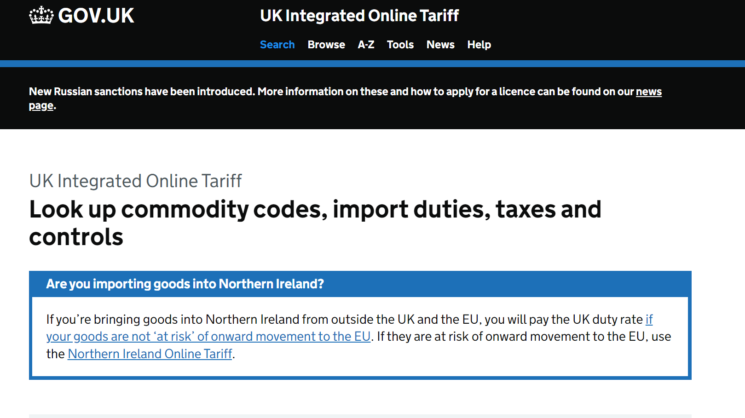
Navigating the CDS Tariff Rules
It will be helpful to both Software Developers and Declarants to familiarise themselves with the CDS Declaration Completion Instructions for Imports and Exports before completing a declaration. Visit UK Trade Tariff: Volume 3 for CDS for help.
Declaration Categories for Imports & Exports
Commodity Codes
Procedure Codes for Imports & Exports
Additional Information Statement Codes
Documents & Reference Codes
Authorisation Type Codes
The new Duty Calculator can be accessed via Trade Tariff: look up commodity codes, duty and VAT rates.

Slide 23
Useful GOV.UK Pages
Software Developers may find the below links helpful for understanding the Declarant’s migration journey.
1
CDS Collection
This page brings together information about CDS.
Step-by-Step Guides
How to import goods into the UK, or export goods out of the UK, including how much tax and duty may be required, what controls are in place and whether a licence or certificate is needed.
2
CDS Declaration Completion Instructions for Imports and Exports
These guides provide detailed completion instructions for data elements when making Import and Export Declarations on CDS.
3
4
Example Declarations
Help using example declarations for Imports and Exports.
CDS Communication Pack
The CDS Communication Pack is where all the information to help declarants prepare to move to CDS will be published.
5

Slide 24




Guidance
Below you will find support information to guide you through your journey to CDS Live.
Due diligence: it is important that Declarants ensure they have populated all the required data elements in their declaration correctly. They should also check if they need to submit any additional supporting documentation.
Do not use TDR for performance or technical testing.
Please ensure a Declarant requests access to CDS Live in advance to avoid delays.
Refer to GOV.UK for extra guidance.
Communicate and coordinate with all parties including CSPs to ensure a smooth submission process in CDS Live.
Review the Customs Declaration Toolkit.
Please use CDS error codes to view the most common errors that Declarants may face.
You will also find tutorials on Developer Hub covering a broad range of topics including:
Issuing a Get request.
Accessing an application–restricted endpoint.
Accessing a user-restricted endpoint.
There are several Trade Associations, Groups and Forums representing UK freight forwarders. These organisations support businesses involved in the movement of goods internationally on behalf of Importers and Exporters. Use their websites to keep up to date with the latest news, training, events.

Slide 25
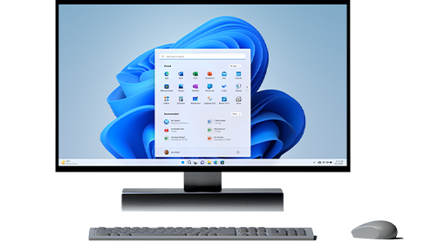
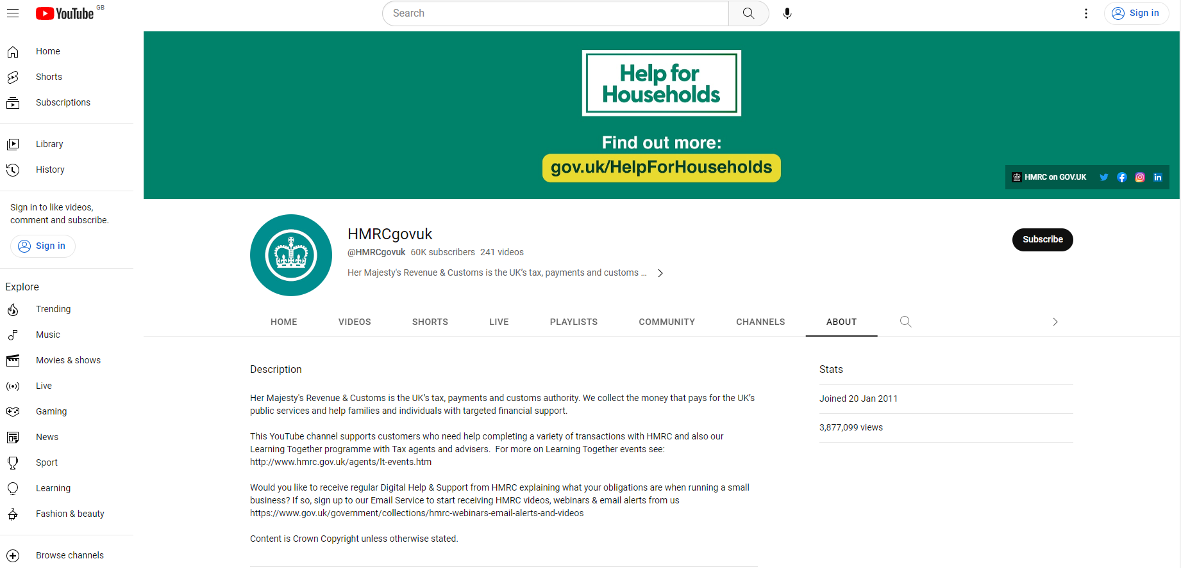
Video Guides
Useful videos to support both Software Developers and Declarants.
HMRC’s ‘How to’ videos:
CDS – General
Supplementary Declarations
Sending Goods out of the UK
New Rules for Exports
Clearance Instructions for Exports
Clearance Instructions for Imports

Slide 26
Query Process

Slide 27
Contacting HMRC
Our query process:
SDST
This mailbox is for queries regarding TT. This is for Software Developers only.
Email: SDSTeam@hmrc.gov.uk
1
Team receive query via email.
2
Team open query as a ticket.
TDR Communications Mailbox
This mailbox is for queries regarding TDR, such as access & rejection queries.
Email: tdrcommunications@hmrc.gov.uk
3
Experts are assigned to investigate.
4
Resolution is found.
CDS Operations
This mailbox is for queries regarding the CDS Live service.
Email: cds.operations@hmrc.gov.uk
CDS problems can also be reported via an online form
5
Team issue an email reply.
Before contacting HMRC, Software Developers should review queries to ensure they are not software related.

Slide 28
Glossary

Slide 29
Definitions
Definitions of keywords and acronyms that are frequently mentioned.
1
AFSS
AFSS (Association of Freight Software Suppliers) brings together and represents many of the leading suppliers of software to the freight and transportation industry.
2
AICES​
AICES (Association of International Courier and Express Services) represents members on matters related to the business of providing international express services, particularly with Government departments and agencies.
3
API (Application Programming Interface)​
An API is a software intermediary that allows two applications to talk to each other. An API delivers a user response to a system and sends the system’s response back to the user.
4
BIFA
The British International Freight Association, also known as BIFA, is the prime United Kingdom trade association representing UK freight forwarders.

Slide 30
Definitions
Definitions of keywords and acronyms that are frequently mentioned.
5
CSP (Community System Providers)​
Independent trade systems that directly interface with HMRC frontier systems. CSPs track the movement of goods within ports and airports, enabling them to operate more efficiently.
6
DMSCLE (Notification Message)
This message informs the submitter that the declaration is now cleared, and by implication, the goods can be released.
DMSTAX (Notification Message)
With this message, the submitter is informed of the duties liable. It can either inform on what has been reserved against a deferment account or similar method of payment. Alternatively, it can be used as a payment instruction for immediate methods of payment. In the immediate payment scenario, a payment reference is also provided.
7
8
DMSREJ (Notification Message)
With this message, the submitter is informed that the received message has been rejected. This can apply to declarations and additional messages.

Slide 31
Definitions
Definitions of keywords and acronyms that are frequently mentioned.
9
EAL (Export Arrival at Location) Message
An EAL message notifies CDS that the goods have arrived at the Office of Export/Office at Exit, at which point they come under customs control.
10
EDL (Export Departure from Location) Message
An EDL message notifies CDS of the departure of goods from the UK. The message also notifies CDS of transport details for the departure.
11
MRN (Movement Reference Number)
An MRN is a customs identification number that’s created each time an import or export declaration is submitted. The number generated is bespoke, allowing goods to be uniquely linked to the declarant.
RESTful APIs​
A RESTful API is an architectural style for an application program interface (API) that uses HTTP requests to access and use data. That data can be used to GET, PUT, POST and DELETE data types, which refers to the reading, updating, creating and deleting of operations concerning resources.
12

Slide 32
Definitions
Definitions of keywords and acronyms that are frequently mentioned.
13
SDST (Software Developer Support Team)
This team supports software developers during development and testing of their product.
14
SWD (Software Developer)​
A SWD is an acronym commonly used when describing Software Developers. Your Software Developer is the third-party software provider enabling your access to HMRC services.
15
TDR (Trader Dress Rehearsal)
TDR is a free service that is designed to help you prepare for CDS Live. It is Declarant focused and lets you submit different declaration scenarios in a simulated environment.
16
TT (Trade Test)
A functional test platform where 3rd party developers can assure their software integration against CDS APIs and a CDS back-end for all core declaration processes and notification types.

